Slide 1

Case Study
Full Stack Candidate Coding Challenge
Solution Submitted by —
Ronit Mishra

Slide 2
Requirement
Create a dashboard with the provided dataset
Specs:
- A service that exposes the data via API(s) to be consubme by a web page (UI)
- A web page that displays a report with possibility to filter data per user
- Reporting dashboard should display general statistics such as Average completion time, who completed faster etc
Auxiliary Stories:
- Any additional reporting, such as Search by time, Course Completion Rate, Shorter & Longer Course based on average completion time etc

Slide 3
React based Web UI
Dashboard created using React.js bootstrapped with create-react-app, styled with Material UI
A lightweight React.js wrapper around Chart.js for visualizations.
For demonstration purpose dashboard will be deployed on Firebase
Proposed Solution
1

Slide 4
RESTful Data Services using Flask
Using Flask, a microframework based on Python to create REST APIs to serve data for the dashboard.
Using Swagger UI for to generate interactive documentation based on OpenAPI Specifications that lets your users try out the API calls directly in the browser.
For demonstration purpose data service will be Dockerized and deployed on a Heroku dyno.
Proposed Solution
2

Slide 5
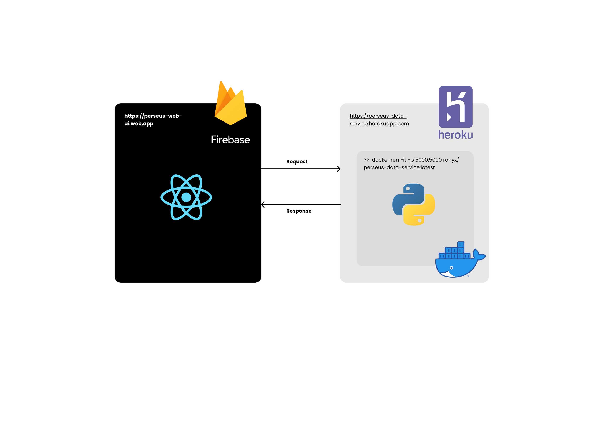
High-level Architecture

Slide 6
Deliverables
Case Study Demo:
Dashboard: https://perseus-web-ui.web.app
Data Service: https://perseus-data-service.herokuapp.com
Source code available at the following GitHub repository:
https://github.com/pyronlaboratory/perseus

Slide 7
References
Following online resources were used during the development of this case study
https://reactjs.org/
https://material-ui.com/guides/api/
https://flask.palletsprojects.com/en/2.0.x/
https://devcenter.heroku.com/
https://firebase.google.com/docs
https://docs.docker.com/
and good old.. https://stackoverflow.com/

